Slide 1
CSC 240 — OPERATING SYSTEMS
F1 CAR ECUs
AS REAL-TIME OPERATING SYSTEMS
How the brain of a 1,000 HP machine is also a masterclass in OS concepts
18,000
RPM
Dhruv Sethi · One Cool Thing Presentation · April 15. 2026

Slide 2
WHAT IS AN ECU?
Engine Control Unit — the computer at the heart of every F1 car
Mandated by FiA
150+
Since 2008, all teams use a McLaren Applied ECU
Sensors monitored
Processing Power
1,000 Hz
Dual-core CPU running at ~100 MHz with real-time guarantees for every operation
Sampling rate
Data Throughput
1 ms
Processes over 150 channels of sensor data simultaneously
Max response time
Inputs Managed
20 kg
Throttle, brakes, fuel injection, DRS, tire temps, suspension, gear shifts
ECU weight limit

Slide 3
REAL-TIME OS: THE CORE CONCEPT
In a regular OS, missing a deadline is annoying. In an RTOS — it's catastrophic.
REGULAR OS
REAL-TIME OS (RTOS)
Best-effort scheduling
Deterministic scheduling
No hard timing guarantees
Hard deadlines enforced
VS
Latency varies by load
Worst-case execution time bounded
Example: Windows, Linux
Example: F1 ECU, aircraft systems
Misses deadline → screen freezes
Misses deadline → crash or worse

Slide 4
PROCESS & THREAD MANAGEMENT
The ECU runs hundreds of concurrent threads, each with strict priority levels
Priority
Function
Deadline
CRITICAL
Fuel injection timing, ignition control
< 0.1 ms
HIGH
Throttle response, brake-by-wire, DRS
< 1 ms
MEDIUM
Traction control, ERS deployment
< 5 ms
LOW
Tire temperature monitoring, telemetry logging
< 50 ms
BACKGROUND
Data compression, team radio comms
Best effort

Slide 5
CPU SCHEDULING: EDF IN ACTION
F1 ECUs use Earliest Deadline First (EDF) scheduling — not Round-Robin or FCFS
D
Fuel Injection
D
Throttle
D
Traction Ctrl
D
ERS Deploy
0ms
1ms
2ms
3ms
4ms
5ms
EDF Rule: Always run the task whose deadline is SOONEST When fuel injection has a 1ms deadline, it preempts EVERYTHING else

Slide 6
MEMORY MANAGEMENT IN THE ECU
No dynamic allocation. No garbage collection. Every byte is accounted for at compile time.
FLASH ROM
FLASH ROM
Program code: read-only, up to 64 MB
SRAM
Real-time working memory: < 8 MB
SRAM
EEPROM
Calibration maps (fuel, ignition timing)
EEPROM
CAN Bus Buffers
Sensor input queues, ring buffers
CAN Bus Buffers
Stack (fixed)
Each task has pre-allocated stack space
Stack
Static memory allocation = no heap fragmentation. The ECU can never run out of memory mid-race — guaranteed

Slide 7
INTERRUPT HANDLING & I/O
Every sensor is an interrupt. The ECU must respond in microseconds — or the driver loses control.
1
2
3
4
5
SENSOR
EVENT
HARDWARE
INTERRUPT
ISR RUNS
DATA
PROCESSED
RESUME
TASK
▶
▶
▶
▶
e.g. Brake pressure spike
Signals CPU immediately
Interrupt Service Routine
preempts current task
Brake bias adjusted in < 1ms
Previous task continues

Slide 8
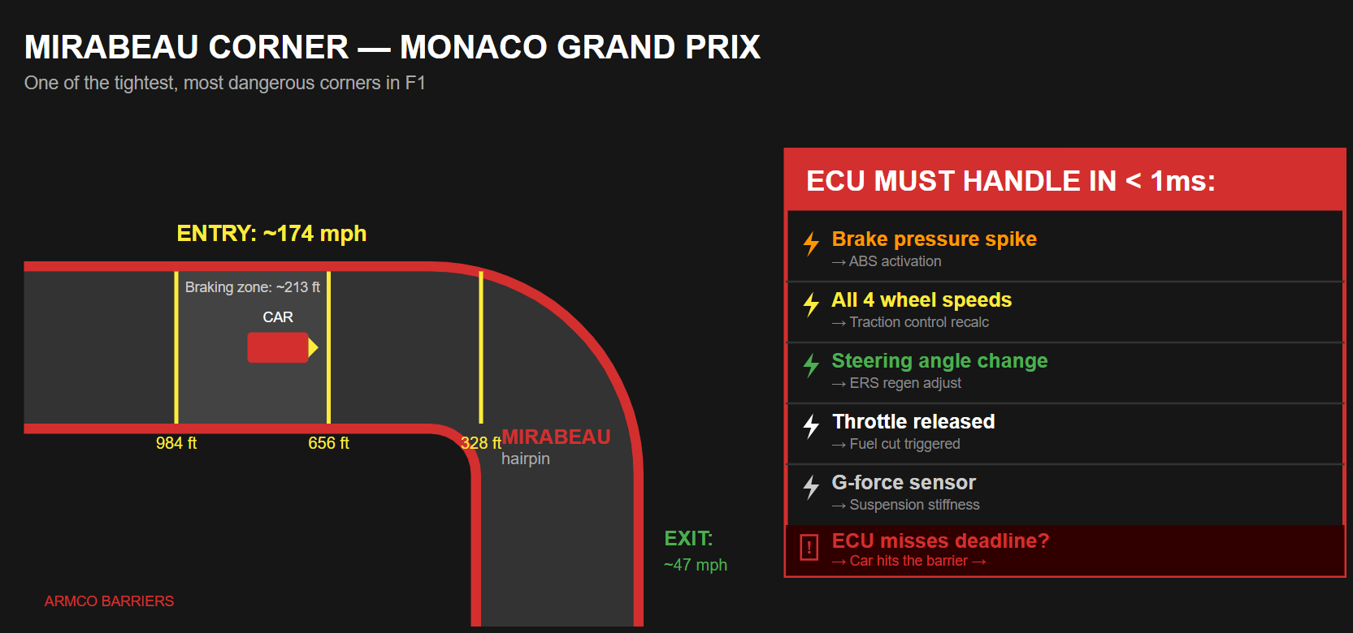

Slide 9
CONCURRENCY & SYNCHRONIZATION
When ERS and throttle both need wheel speed data — who goes first? The ECU has answers.
🔒 Mutex Locks
🚦 Semaphores
Protects shared sensor registers
Grants exclusive write access
Prevents actual race conditions
Manages CAN bus message queues
Multiple concurrent readers, exclusive writers
Real-world producer/consumer problem
⚡ Atomic Operations
🛡 Deadlock Prevention
Used for critical state values
Executes in a single, uninterruptible hardware instruction
Zero locks required
Strict lock ordering protocol
Eliminates circular wait
Example: Throttle lock always before ERS lock

Slide 10
TELEMETRY: THE FILE SYSTEM
F1 cars generate 3 GB of data per race lap. Where does it all go?
F1 TELEMETRY
OS PARALLEL
Sensor reads 1,000 values/sec
File system writes to buffer
Ring buffer holds recent data
Circular I/O queue in kernel
↔
CAN bus transmits via radio
Network socket — TCP/UDP
Pitwall receives & stores data
NFS / remote file system
Engineers query specific laps
Database read with seek()
Car overwrites oldest laps
LRU cache eviction policy

Slide 11
KEY TAKEAWAYS
Every race is also a live OS in action
01
RTOS ≠ Regular OS
Hard real-time guarantees mean no missed deadlines ever — F1 safety depends on it
02
EDF Scheduling
Earliest Deadline First — the same CPU scheduling algorithm we studied, running 18,000 times per minute
03
Static Memory Only
No malloc(), no heap — every byte pre-allocated to eliminate fragmentation and unpredictability
04
Interrupts Drive Everything
150+ sensors each fire hardware interrupts — the ISR hierarchy IS the I/O management system
05
Concurrency Without Deadlock
Mutex locks and lock ordering prevent race conditions at 340 km/h — Coffman's conditions applied in steel

Slide 12
LIGHTS OUT.
AND AWAY WE GO.
Thank you
Questions?
Dhruv Sethi · CSC 240 Operating Systems · Rider University · April 15, 2026

